Slide 1

Protocol Design Considerations
Version 1, Presented at QuTech (Delft) on 22 November 2019

Slide 2
A few true stories…

Slide 3
Designing correct protocols is hard
On 27 October 1980, all routers in the entire Internet had to be rebooted simultaneously to recover from a protocol design weakness.
http://www.hannaypublications.com/portfolio/wp-content/uploads/2016/02/AppliedComms_A2.pdf

Slide 4
Version numbers to pick newest message
Message
Version number 8
<
Message
Version number 40
<
Message
Version number 44
Oldest version
Newest version
Note: this mechanism is still used today, for example in OSPF and ISIS link state flooding

Slide 5
Modulo 64 comparison creates ”loop”
Message
Version number 8
Z
44 < 8
(modulo 64)
8 < 40
(modulo 64)
Message
Version number 44
Message
Version number 40
40 < 44
(modulo 64)
Version field was unsigned 6 bit integer, so math is modulo 64
Competing message versions kept replacing each other forever, eating up all CPU
The versions were introduced to a double bit error, which was not detected because check-sums were disabled.

Slide 6
Still making the same mistakes today
A similar problem exists in the BGP specification and is observed in the Internet to this day.
See BGP persistent route oscillations (RFC3345)

Slide 7
Implementing protocols correctly is hard
A bug in a widely used BGP implementation allowed an attacker to advertise a BGP route that caused many BGP routers on the other side of the world to crash.
Sending a specially constructed 4-octet AS-path caused certain routers to crash CVE-2014-3818 https://securitytracker.com/id/1031009

Slide 8
Protocol security is hard
A BGP vulnerability enabled hackers to rob a bitcoin bank.
https://www.wired.com/2014/08/isp-bitcoin-theft/

Slide 9
Flow control Congestion control Error control (reliability) in the data plane

Slide 10

Flow control
Make sure sender does not produce data faster
than receiver can consume them.
Consume 3 pps
Send 5 packets per second (pps)
Receive buffer overflows.
Buffer can absorb bursts but not sustained rate difference.
Drop 2 pps
Note: here it is the receiver that is not keeping up; the network can keep up fine.

Slide 11
Flow control in quantum network
Make sure sender does not produce qubits faster
than receiver can consume them.
Bell pair
Ideally, it is produced “fresh” just before we have a qubit to teleport
Qubit that has been teleported
Receiver needs to store it in memory until it is consumed (measured)
Qubit to be teleported
Sender never stores more than one “qubit to be sent” in memory
Consumer can run out of qubit memory ifs sender sends too fast

Slide 12
Flow control approaches
General principle: make the data arrive more slowly
Approach 1: Sliding window
It is okay to receive data later (delay in-sensitive traffic)
Web pages, file transfer, e-mail, …
Receiver makes the sender slow down
Approach 2: Adaptive encoding
It is not okay to receive data later (delay-sensitive traffic)
Voice, live video, video on demand, …
Receiver makes the send send less data
Sender must be able to back-pressure application

Slide 13
Sliding window
Window size = 5
Window size = 3
Window size = 0
Window size = 2
Consumed

Slide 14
Bandwidth-delay product
100 Gbps, 5000 km (= 50 ms round-trip @ speed of light in fiber)
window size 800 Mbit @
100 Gbps = 8 ms
Round-trip time 25 ms
In this example window size (= receive buffer size) is 100 MB = 800 Mbit
Only 32% of available bandwidth is used.
Window size must be ≥ bandwidth * round-trip delay to fully utilize available capacity.

Slide 15
Congestion control
Make sure senders do not produce data faster
than network can carry it.
Send link-rate
Send link-rate
Try to send 2x link-rate traffic on link.
Transmit buffer overflows.
Drop half of traffic.

Slide 16
Congestion control in quantum networks
End-points cannot get more end-to-end Bell pairs per second (Bpps) than network can produce them
based on bottleneck link or router.
10 Bpps
10 Bpps

Slide 17
Congestion control
Mechanisms to avoid congestion
General principle: send traffic more slowly when congestion occurs
Detect dropped packets at transport layer and reduce window
TCP slow start algorithm
Extremely difficult to ”get right” (TCP Reno, Vegas, high speed, BIC, CUBIC, C2TCP, NATCP, Elastic TCP, and many many more variations)
Assumes everyone “plays fair”
Backwards Explicit Congestion Notification (BECN)
@@@
Forward Explicit Congestion Notification (FECN)
Set bits in forwarded IP packet: Congestion Encountered (CE)
Requires cooperation from the transport layer to slow down

Slide 18
Active Queue Management (AQM)
Mechanism for dealing with congestion when it does occur
Decide which packet to service next in the send queue
Classification: @@@
Hierarchical schedulers: @@@
Shapers: @@@
Decide when to start dropping packets
Tail-drop
Random Early Drop (RED)
Decide which packet to drop
In-profile vs out-of-profile

Slide 19
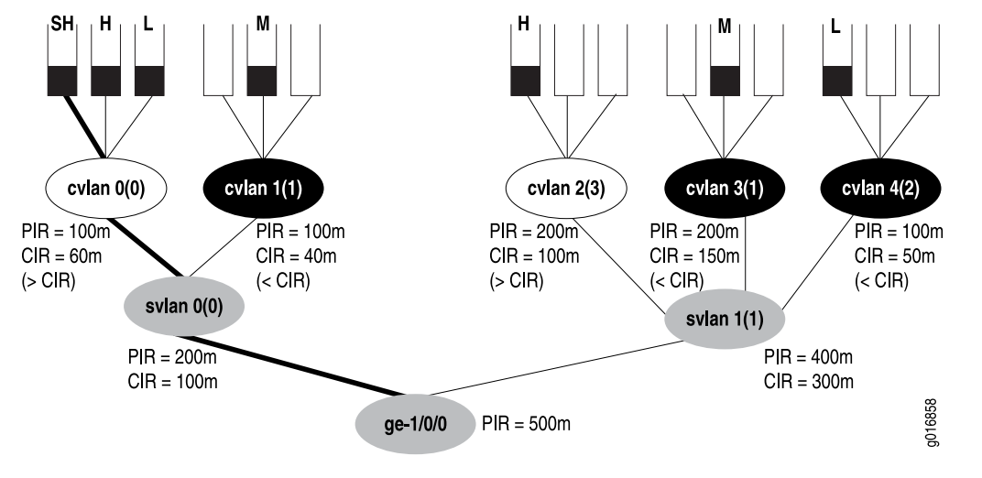
Hierarchical queue scheduler
Source https://www.juniper.net/documentation/en_US/junos/information-products/pathway-pages/cos/config-guide-hierarchical-cos.pdf

Slide 20
Reliable transport @@@
Error detection and recovery
1
2
3
4
5
6
7
8
9
10
11
12

Slide 21
Error detection mechanisms
@@@

Slide 22
Error recovery mechanisms mechanisms
@@@

Slide 23
Reliable transport (error control)
@@@ Picture

Slide 24
Reliable transport approaches
@@@ ACK
@@@ NACK
@@@ Selective ACK

Slide 25
Mixing up flow, congestion and error control
@@@ bad idea @@@
@@@ sender cannot distinguish
slow receiver
@@@ re-ordering packets is disastrous

Slide 26
Soft state versus Hard state

Slide 27
Soft state vs hard state
Sender wants to advertise some data (e.g. a route) to receiver.
Soft state protocol
A.k.a. Periodic protocol
Sender initially sends data.
Receiver puts data in its database.
Sender periodically resends data.
If receiver doesn’t receive data anymore, it removes data from its database after time-out.
Heavy load due to periodic transmission.
Fallacy: simpler cleanup when sender crashes.
Hard state state protocol
Runs protocol over reliable transport connection.
Sender initially sends data.
Receiver puts data in its database.
No periodic re-transmissions of data.
Receiver keep data in database until (a) sender explicitly withdraws data or (b) transport connection is disconnected.
No traffic if no changes in the database.
Needs reliable transport connection and keep-alive mechanism.

Slide 28
Flow control Congestion control Error control (reliability) in the control plane

Slide 29
Explosions and oscillations in your network

Slide 30
Packet replication loops
Packet replication Making multiple copies of a packet when you forward it (e.g. multicast) +
Forwarding loop
=
Network meltdown
Due to explosion of traffic

Slide 31
Packet replication loops
Packet replication Making multiple copies of a packet when you forward it (e.g. multicast) +
Forwarding loop
+
Absence of TTL mechanism
Packets can loop forever without TTL expiring
=
Disastrous nearly unfixable network meltdown
Due to explosion of traffic which doesn’t go away, even after you shut up the source

Slide 32
Example: Ethernet address learning + SPT
Packet replication Making multiple copies of a packet when you forward it (e.g. multicast) +
Forwarding loop
=
Network meltdown
Due to explosion of traffic

Slide 33
Triggered state machine loops

Slide 34
Run-away replication
Ethernet example

Slide 35
Undampened control feedback loops
Failed attempts at delay routing

Slide 36
Undampened state machine feedback loops
RIFT example

Slide 37
Multi version Multi feature Multi vendor

Slide 38
Interop between protocol versions
Version X needs to interoperate with version Y.
For any X and Y, not just Y = X + 1.
Don’t assume contiguous “regions” of same version.
Different devices will run different version of your protocol.
Temporarily during upgrade. You cannot upgrade your devices all at once; it takes a lot of time.
Or semi-permanently due to operational considerations (e.g. different vendors support different versions of the protocol). You want to be able to have multiple vendors in the same network.
Version 1
Version 2
Version 1
Version 1
Version 3

Slide 39
Lessons learned from major version bumps
IPv4 vs IPv6
IPv6 is not backwards compatible with IPv4
Upgrading from IPv4 to IPv6 is a royal pain in the neck
It’s been 20 years and IPv6 is still not universally deployed
IPv4 will never go away
OSPFv3 vs OSPFv2
OSPFv3 is not backwards compatible with OSPFv2
You need to upgrade from OSPFv2 to OSPFv3 to get IPv6
Real networks run OSPFv2 and OSPFv3
ISIS did it right (ISIS with IPv6 can interoperate with ISIS without IPv6)
BGPv3 vs BGPv4 vs …BGPv5?
BGPv3 is not backwards compatible with BGPv4, it required every Internet core router to be upgraded
Upgrading every core router on the Internet is infeasible at this time
BGPv4 has excellent extension mechanisms; it is unlikely that there will ever be a BGPv5

Slide 40
Interop between feature sets
Protocol implementation that has feature A must interoperate with protocol implementation that does not have feature A.
Different vendors and versions of code have different feature sets.
Don’t assume the feature set can be derived from the protocol version. Allows protocol extensions to evolve and be deployed independently.
Don’t assume the feature set is the same. Feature set A+B must interoperate with B+C.
A
D
B
C
C
D
A
B
D
A
B
C
Protocol features
A
B
C
D

Slide 41
Capability announcement (“negotiation”)
A
B
C
B
C
D
I support features A, C, D
I support features B, C, D
We can use features B, C (these are the ones we have in common)
We can use features B, C (these are the ones we have in common)
(Things get a bit more complicated when more than 2 devices are involved, e.g. flooding)

Slide 42
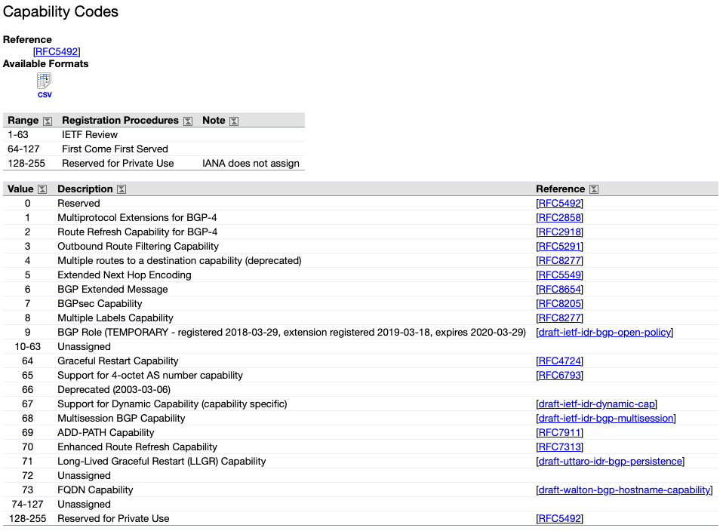
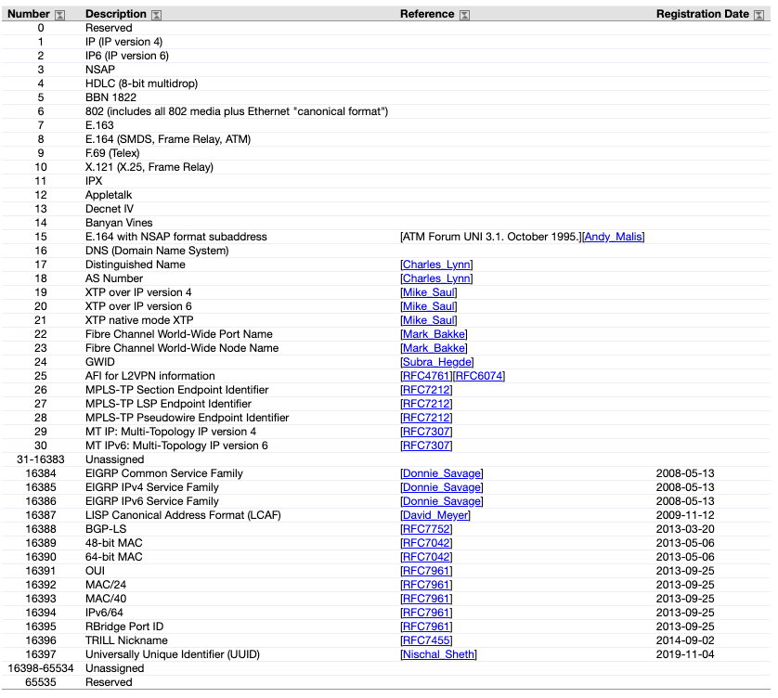
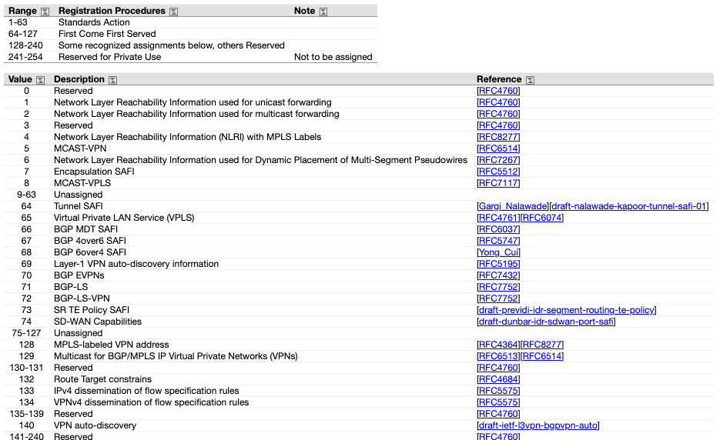
Example: BGPv4 capabilities

Slide 43
Type Length Value (TLV) Encoding

Slide 44
How to handle unrecognized TLVs?
What should you do when you receive a TLV with an unknown type?
Happens when another device is running a newer version of the protocol.
Options:
Ignore and propagate the TLV
Ignore and remove the TLV
Declare an error
Note: ignoring is possible because the length L is known and the value can be skipped
The originator of the TLV (who by definition understands it) sets some extra bits in the TLV to instruct the receiver what to do.

Slide 45
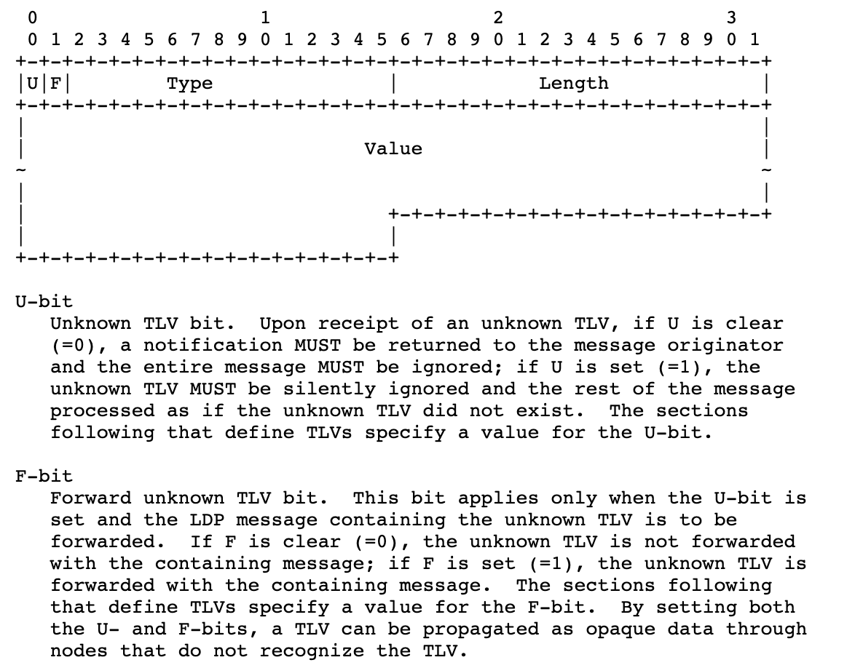
Example: Label Distribution Protocol (LDP)
TLV encoding is also used in:
BGP
OSPF
ISIS
RSVP
Many more…

Slide 46
Planned upgrades Unplanned crashes

Slide 47
Authentication vs encryption

Slide 48
Neighbor authentication

Slide 49
Origin authentication

Slide 50
Path authentication

Slide 51
Control protocol security

Slide 52
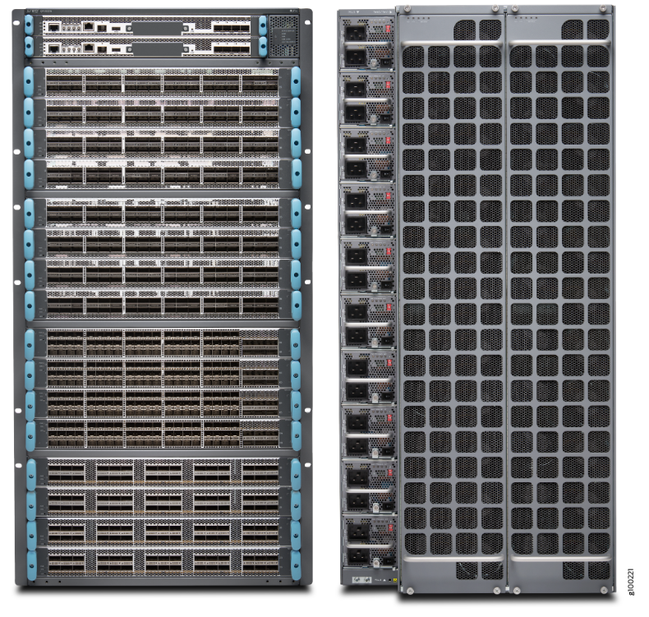
Chassis devices
Redundant control planes (routing engines)
Everything (routing engine, switch fabric, power supplies, fans, …) redundant and in-service replaceable

Slide 53
In-Service Software Upgrade (ISSU)
Active routing engine
Version 1
Active routing engine
Version 1
Active routing engine
Version 1
Active routing engine
Version 2
Standby routing engine:
Version 1
Standby routing engine:
Version 2
Standby routing engine:
Version 2
Standby routing engine:
Version 2
Forwarding engine
Forwarding engine
Forwarding engine
Forwarding engine
Forwarding engine
Forwarding engine
Forwarding engine
Forwarding engine
Upgrade
standby
Switch-over
Upgrade
new standby

Slide 54
Non-Stop Forwarding (NSF) Also known as Graceful Restart (GR)
Control-plane session
PREPARE FOR RESTART
Control-plane session PREPARE FOR RESTART
Active routing engine: version 1
Standby routing engine: version 2
Data-plane traffic
Forwarding engine
Data-plane traffic
Active routing engine: version 1
Control-plane session
RESYNCHRONIZE
Standby routing engine: version 2
Control-plane session RESYNCHRONIZE
Data-plane traffic
Forwarding engine STALE TABLES
Data-plane traffic
Active routing engine: version 1
Control-plane session
RESTART FINISHED
Standby routing engine: version 2
Control-plane session RESTART FINISHED
Data-plane traffic
Data-plane traffic
Forwarding engine

Slide 55
Pizza-box devices
Does not have redundant routing hardware routing engines.
(Sometimes in redundant software routing engines using virtual machines or containers.)

Slide 56
Non-Stop Routing (NSR)

Slide 57
Scale-out instead of scale-up

Slide 58
Relatively small impact of losing one device
For planned upgrades, announce in advance (e.g. overload flag) to shift traffic away, if possible.

Slide 59
Implementation correctness is hard. Much harder than you think.

Slide 60
Don’t hand-code your parsers
Type Length Value (TLV) encoding (we saw this before!)
Formal modeling language for on-the-wire protocol
Abstract Syntax Number 1 (ASN.1)
YANG
Google Protocol Buffers (BGP), Thrift, etc.
@@@ Example of real-life bug

Slide 61
Thank you.

Slide 62
References
Some lessons from history (“Those who do not know history are doomed to repeat it”) https://datatracker.ietf.org/meeting/102/materials/slides-102-rtgarea-those-who-do-not-learn-history-are-doomed-to-repeat-it-00

